Slide 1
Generating Pictures of Histories
and Abstract Executions
Name: Xue Jiang

Slide 2
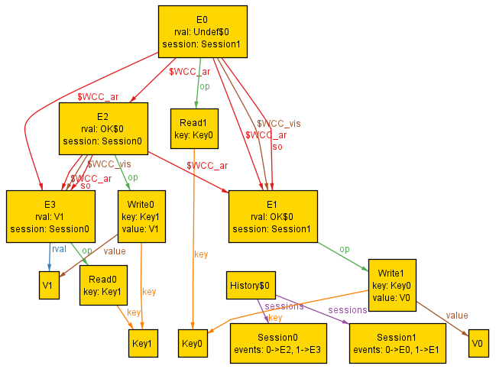
Non-transaction
Goal: Generating pictures of abstract executions and corresponding histories
Abstract execution generated by Alloy*

Slide 3
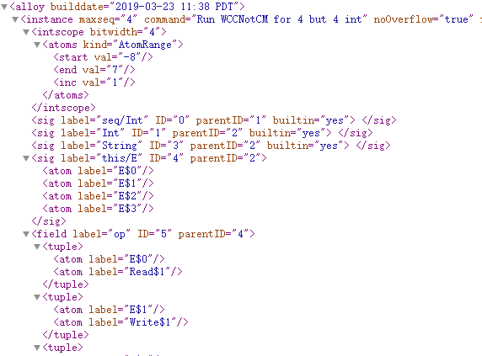
Input: xml Files

Slide 4
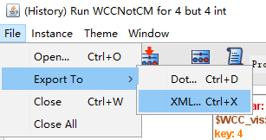
Input: xml Files
How to get xml files？
Exported from Alloy* GUI
Using Alloy Java APIs
d
http://alloytools.org/documentation/alloy-api/index.html

Slide 5
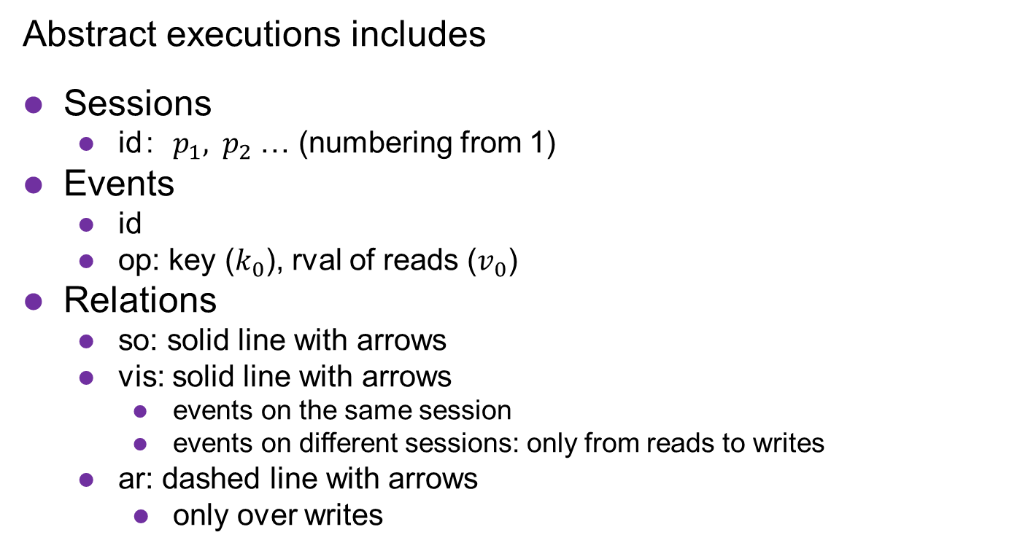
Output
Abstract executions includes
Sessions
id：$p_{1}, { p}_{2}$ … (numbering from 1)
Events
id
op: key ($k_{0}$), rval of reads ($v_{0}$)
Relations
so: solid line with arrows
vis: solid line with arrows
events on the same session
events on different sessions: only from reads to writes
ar: dashed line with arrows
only over writes
Histories includes session ids and events and so relation

Slide 6
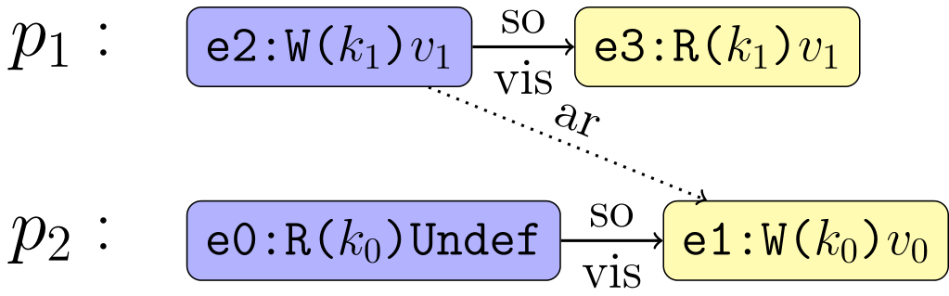
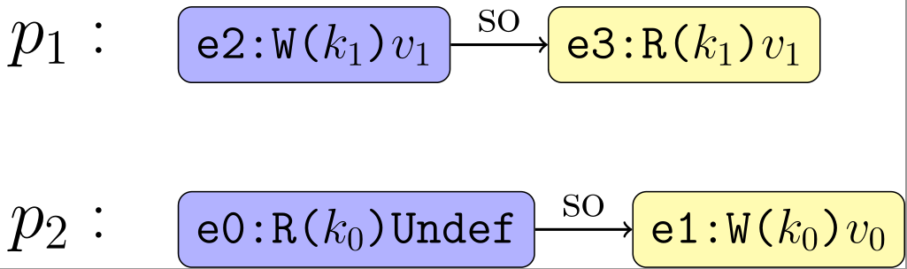




Example
$S_{1}$:
$S_{2}$:
Abstract execution
$S_{1}$:
$S_{2}$:
History

Slide 7
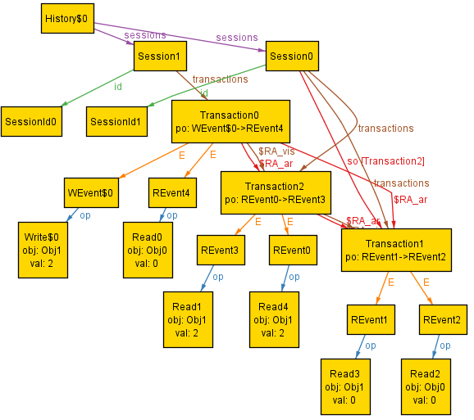
Transaction
Goal: Generating pictures of abstract executions and corresponding histories
Abstract execution generated by Alloy*

Slide 8



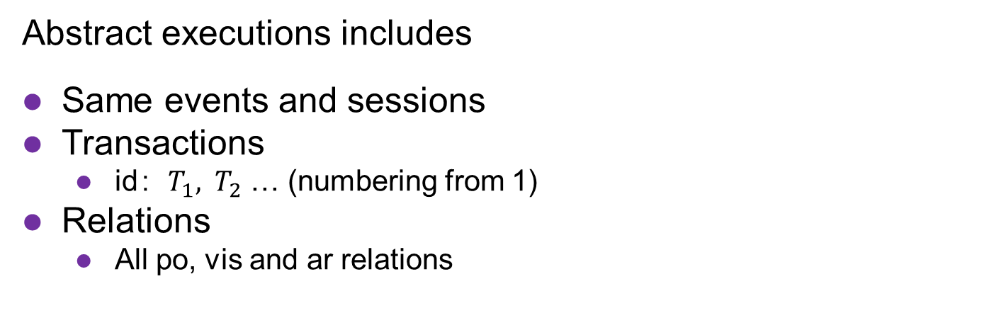





Output
Abstract executions includes
Same events and sessions
Transactions
id：$T_{1}, { T}_{2}$ … (numbering from 1)
Relations
All po, vis and ar relations
Histories does not includes vis and ar relations
$$T_{3}$$
$$T_{2}$$
po
vis
po
$S_{1}$:
$R\left(o_{1}\right)2$ $R\left(o_{1}\right)2$
$R\left(o_{1}\right)0$ $R\left(o_{0}\right)0$
ar
vis
ar
Abstract execution
po
ar
$S_{2}$:
$W\left(o_{1}\right)2$ $R\left(o_{0}\right)0$
$$T_{1}$$

Slide 9
Reference
Herd
Graph modes: http://diy.inria.fr/herd

Slide 10
Thank you !

